Slide 1
lollms-jev
Calibrated typed decisions from a small language model: the problem, the architecture, the evidence.
Research prototype · for AI researchers

Slide 2
The problem to solve
CONTEXT
Software keeps asking large generative models small questions whose answers are a label, a yes or no, or a number.
Slow and costly
Hard to trust
Hard to run locally
A full generation is paid for a one-token answer, at every pipeline step.
The answer arrives as free text to parse, and a stated confidence is not a calibrated probability.
Small local models are fast but rarely give a dependable output format.
Research question. Can a 0.5-2B model, fine-tuned once, make such decisions in one forward pass, with probabilities we can trust?
lollms-jev · 2 / 9

Slide 3
What a solution must offer
REQUIREMENTS
Typed output
Calibrated
Small and local
A choice, a yes/no or a 1-K score, over options that change on every call.
A probability that matches how often the model is right, so thresholds mean something.
One forward pass on a 12 GB card, no API, exportable to ONNX and GGUF.
Prior art: Jev (TypeSafe AI), Qwen3.5-4B-Jev-Judge, Tev1-0.8B-experimental, LLM-as-Jev (arXiv 2610.02076)
lollms-jev · 3 / 9

Slide 4
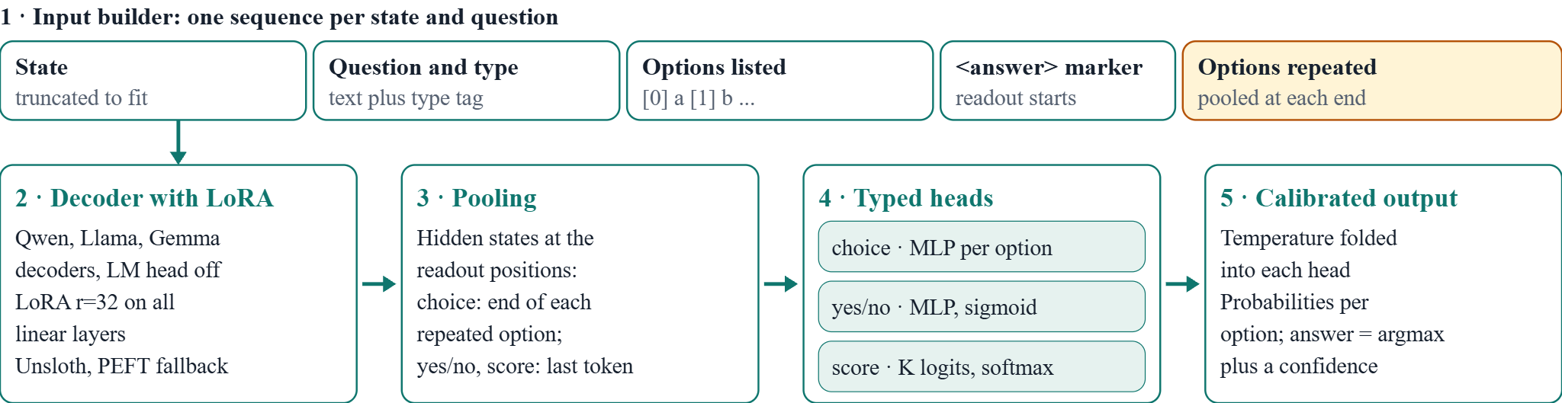
Architecture: the components
SYSTEM
Training minimises soft-target cross-entropy (choice), binary cross-entropy (yes/no) and cross-entropy plus squared EMD (score), with AdamW (LoRA 2e-4, heads 1e-3). Export: merged Hugging Face model, one ONNX graph for backbone and heads, or a GGUF backbone with the heads in a separate file.
lollms-jev · 4 / 9

Slide 5
Readout and heads
MECHANISM
Readout under causal attention
Heads and losses
Options are listed, then repeated after an answer marker. We pool the repeated copy, so every option has seen all the others, with no custom masks (Qwen3.5 DeltaNet layers rule them out).
Choice: a small MLP scores each option, softmax over a per-row option set. Yes/no: sigmoid. Score: softmax over 1-K with an ordinal EMD loss. All trained on soft targets.
lollms-jev · 5 / 9

Slide 6
Data and labels
DATA
Store
Real labels
Distilled labels
SQLite rows of state, typed question and soft target. Splits follow the context, not the row, so no document leaks.
Hub classification, ratings, yes/no and multiple choice with per-row options; Jev-format gold labels.
A teacher through lollms_client votes k times with shuffled options; the votes become soft targets.
Exact labels
Routing
Recipes
Solver-labelled games (tic-tac-toe, Nim, blackjack, mazes, rock-paper-scissors) and Lichess chess puzzles.
A cleaned router dataset plus teacher-made model rosters with capability cards.
Presets pick datasets by goal: sorter, guard, judge, reader, thinker, agent.
lollms-jev · 6 / 9

Slide 7
Training and calibration
TRAINING
Recipe
Against shortcuts
LoRA r=32 on all linear layers, Unsloth by default with a plain PEFT fallback, 4096 tokens, token-capped batches.
Options are reshuffled every step, and some rows lose the right answer and gain a none-of-the-above option.
Calibration
Pause and resume
One temperature per head, fitted on held-out rows and folded into the last linear layer: nothing to apply at inference.
Resume points every 50 steps. On CPU, a paused-and-resumed run ended with weights identical to an uninterrupted one.
lollms-jev · 7 / 9

Slide 8
Evaluation: what the numbers mean
EVIDENCE
Held-out rows, split by context
Generalisation within the training sources.
Held-out sources
Transfer to datasets never trained on.
Official test splits vs frozen base
Does training beat the unmodified LM read from its own logits?
AUROC and best-cutoff accuracy
Ranking quality, next to sensitivity to the 0.5 threshold.
ECE
Calibration against the dataset labels. With teacher labels, it measures agreement with the teacher.
lollms-jev · 8 / 9

Slide 9
Shipping, status and open questions
OUTLOOK
Shipping
Open questions
Merge the LoRA (hidden-state parity 2e-6 on a tiny model), ONNX with optional int8, GGUF backbone with heads beside it, and a Hub push with a generated card including benchmarks.
Does a trained head beat the frozen readout at 0.8B? Real Qwen3.5-0.8B on a 12 GB card is untested here. Is the model invariant to the option set? GGUF runtime glue is missing.
Status: research prototype. Checked on tiny random models; real-model results are still to be measured.
lollms-jev · 9 / 9

